Slide 1


LITERATURE REVIEW vs. ANNOTATED BIBLIOGRAPHY
writingsupport@uwindsor.ca
Writing Support Desk

Slide 2
Lit Reviews & Annotated Bibliographies
Summarize useful information on a topic in one place
Identify gaps in research
Analyze methods and biases in past research
Provide background to your own work or future research
Explore existing research

Slide 3

Literature Review: Survey
Summarizes and synthesizes research on a given topic
Often centres around a specific research question or theme
Organized by theme, not by article (discusses multiple articles per paragraph/section)

Slide 4
Literature Review: Critical Article Review
Organized by article, not by theme
In-depth analysis of each article's methods
Discusses gaps/future research opportunities
Covers each article individually

Slide 5

Annotated Bibliography
Tends to discuss value/usefulness of given sources to a future project
Organized by article, not by theme
Summary of each article, often followed by discussion of its usefulness
Typically precedes a larger assignment

Slide 6
WHICH ONE AM I SUPPOSED TO WRITE???
Lit Review: Survey
Lit Review: Critical
Annotated Bibliography
These terms are sometimes used interchangeably. Confusing, right?
Check your assignment instructions, and if you're still not sure, clarify with your instructor.

Slide 7
STEP-BY-STEP
1. Identify & Focus
2. Research & Analyze
3. Organize & Write
LITERATURE REVIEW: SURVEY

Slide 8


STEP ONE: IDENTIFY & FOCUS
4

Slide 9

FOCUS IN ON A TOPIC & RESEARCH QUESTION
For example, a broad topic might be ‘Women’s involvement in radio’
A specific research question might be ‘What factors influence women’s involvement in campus-community radio?’
6

Slide 10

PRO TIP: LET YOUR RESEARCH GUIDE YOU!
4

Slide 11


STEP TWO: RESEARCH & ANALYZE
4

Slide 12

WHERE TO START?
Leddy Library journals database
Consult with the librarian for your discipline at Leddy
Google Scholar
Bibliography mining
Wikipedia and Google for general information or bibliography mining (not as a final source)
6

Slide 13

READ & ANALYZE
What are the methodologies used?
Are there any assumptions or biases in the articles?
Are there any theories or results that conflict with one another?
Do some theories or ideas appear in the research more frequently than others?
6

Slide 14

PRO TIP: TRY A DOUBLE-SIDED JOURNAL
4

Slide 15
DOUBLE-SIDED JOURNAL
ONE SIDE SUMMARIZES RESOURCE MATERIAL
What are the main ideas?
What perspective does the author take?
What types of evidence does the author use?
ONE SIDE RECORDS YOUR RESPONSE TO IT
Do you agree or disagree?
How does it differ from your perspective?
Are there any discrepancies in the evidence?
38

Slide 16
DOUBLE-SIDED JOURNAL
“WOMEN TAKE TO THE AIRWAVES” - Garofoli
Radio (spec. talk radio) problematically dominated by men
Lack of women on air is political
Stats re: numbers of women on air. Qualitative data re: democratization
ONE SIDE RECORDS YOUR RESPONSE TO IT
Def. a problem, evident in mainstream and indie radio
Hadn’t considered right wing slant of most talk radio
Speculates about the democratizing potential without many examples
38

Slide 17

KEEP TRACK!
Record important research as you go
Track links, citation information, important quotes, page numbers
Use colour coding to help you organize the research by theme
6

Slide 18

STEP THREE: ORGANIZE & WRITE
4

Slide 19

ORGANIZE PAPERS BY COMMONALITY
Which papers have common methods?
Which papers have common results?
Which papers have common trends?
What is different about their methods/results/findings?
6

Slide 20

OUTLINE YOUR LIT REVIEW
Organize by topic, not by resource
Don’t just list articles; let the articles talk to each other
Use subject headings if it helps. For example
Presence of women in radio
Reported barriers
Elitist environment
Family commitments
Safety
Lack of confidence
6

Slide 21
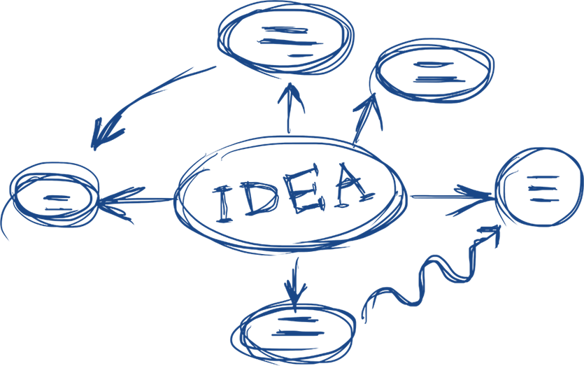
OUTLINE YOUR LIT REVIEW
What gap are you going to fill?
Why is this important?
Lit review provides background the reader needs to see why your research is worthwhile
6

Slide 22
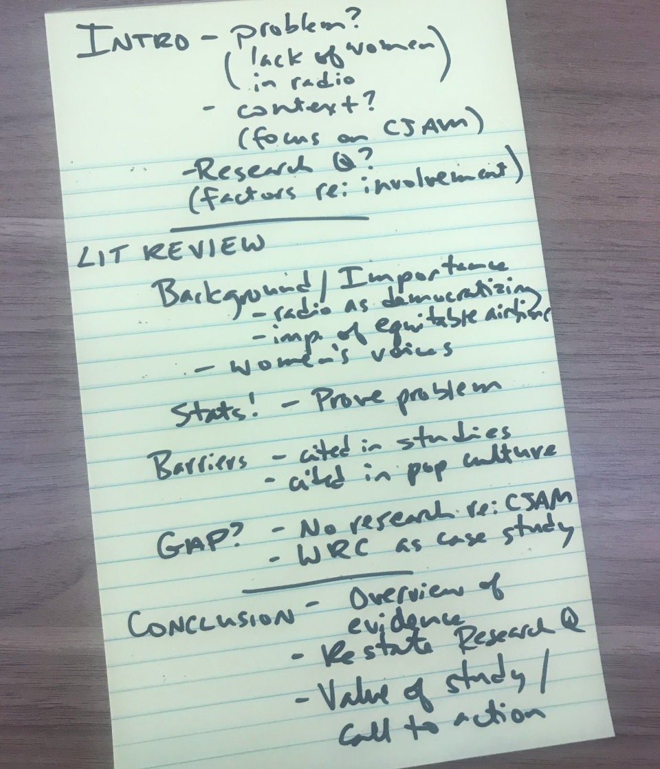
PRO TIP: CREATE A SKELETON OUTLINE
4

Slide 23

INTRODUCTION
PROBLEM – lack of women in radio
Context & focus (priorities of campus-community radio)
Specific focus – campus-community radio
RESEARCH QUESTION – factors influencing women's involvement
6

Slide 24

BODY PARAGRAPHS
Organize body paragraphs by theme (use subheadings if you need)
Explore several articles per paragraph
Include all major themes and controversies in the research
6

Slide 25

DISCUSSION and/or CONCLUSION
Literature reviews often include a 'Discussion' section that
Highlights key points, gaps, and conflicts
Notes implications for future research/action
Depending on the assignment, a conclusion may function in a similar way
6

Slide 26
BEFORE YOU START WRITING CHECKLIST
Identify and focus in on a research question
Research & analyze what you’ve found
Organize your research & start writing
40

Slide 27

Critical Article Review vs. Survey
A critical article review can be different than a standard 'survey' review
Instead of synthesizing research by topic, it analyzes articles one-by-one, focusing on their research methods

Slide 28
Research Purpose
What did the study set out to do/find out?
Searching for causes/impact/to evaluate or explore something?
Method
Qualitative? What kind? Narrative inquiry? Case study?
Quantitative? What kind? Survey? Meta-analysis? Correlation?
Data Collection
Interviews? Focus groups? Surveys?
Field observations? Experiments? Computer simulations?
Mixed methods? Computer simulations?
Is the method appropriate to the purpose?
Is there a control group?

Slide 29
Sample
Is it representative? Large enough?
Who are the participants? Demographics? What was the response rate?
Data Analysis
How is the dated coded/analyzed? What measures are used?
Are the measures appropriate? Consider reliability and validity
Conclusions
Are the conclusions rooted in evidence?
Check for logical fallacies, confirmation bias
How were they recruited/selected?
What theory is used to analyze data?
Do they note limitations?
Do conclusions agree/conflict with other research?

Slide 30

LINK TO OTHER STUDIES
How does it relate to other studies in the review?
Does it challenge/back up their findings?
Does it use similar/different methods/theories?
Follow this process for each article
6

Slide 31
ANNOTATED BIBLIOGRAPHIES: GET STARTED!
Identify a topic
Research that topic
Review your research & select works to cover
4

Slide 32

BEGIN EACH SECTION WITH BIBLIOGRAPHIC INFORMATION
Waite, L. J., Goldschneider, F. K., & Witsberger, C. (1986). Nonfamily living and the erosion of traditional family orientations among young adults. American Sociological Review, 51, 541-554. http://doi.org/00.000.000
6

Slide 33

ANNOTATE!
Summary of work (purpose, methods, theory, conclusions)*
Note author biases, authority on subject, intended audience, any novel information, links to other studies in bibliography*
Note how it will inform your research
*you do not need to address all of these depending on the work/discipline/what is relevant
6

Slide 34
Literature Review: Survey
Reads like an essay
Allows articles to 'talk to one another'
Organized by theme
Annotated bibliography
Organized by article
Often precedes future projects
Collect research on a topic in one place
All
Can inform future research
Identify gaps/biases
Literature Review: Critical
Organized by article
In-depth look at research methods
Bibliographic entry + summary + short commentary

Slide 35
QUESTIONS?
Remember, this slideshow and many others are available to download via the Writing Support Brightspace page.
Students can self-enroll as 'learners' either by selecting 'Discover' from the Brightspace landing page and clicking 'Enroll' on the Writing Support organization.

